Slide 1
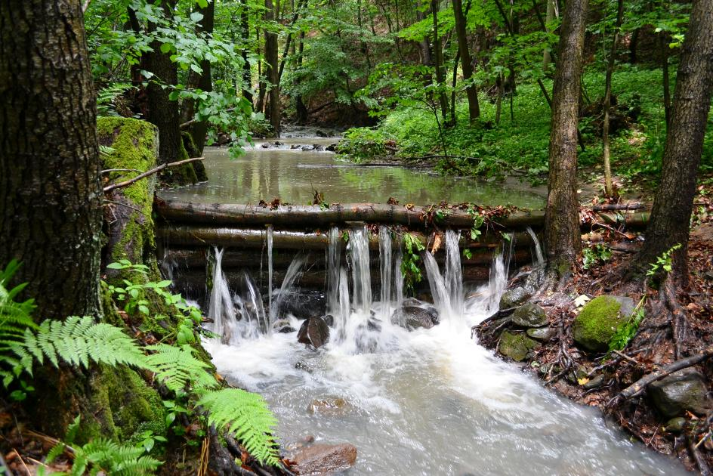

Technical Solutions of Water retention measures
Michal Kravčík, Danka Kravčíková, Slovakia
peopleandwater.international/www.waterholistic.com
Daia, April, 15th 2026

Slide 2
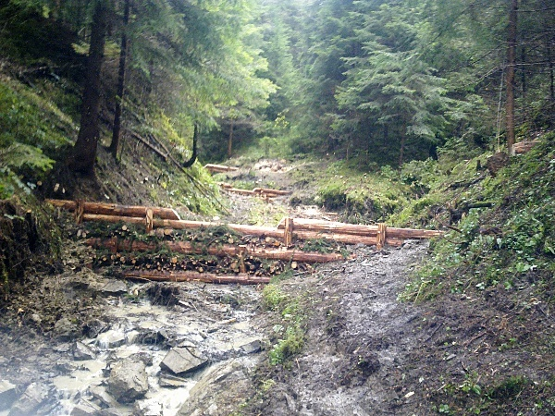
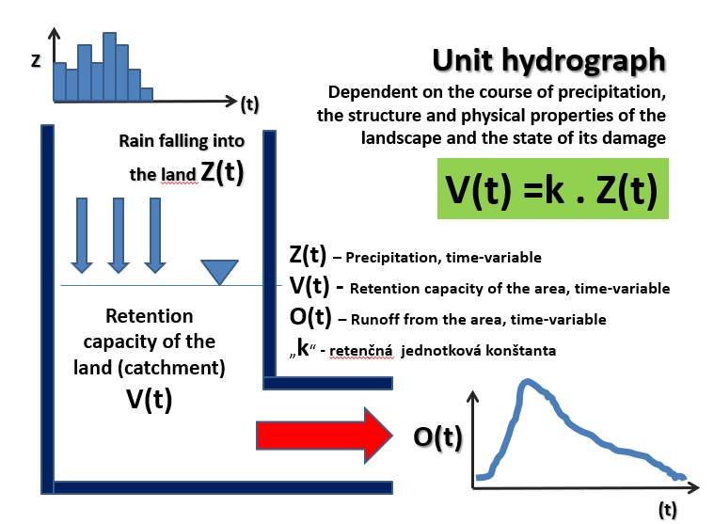
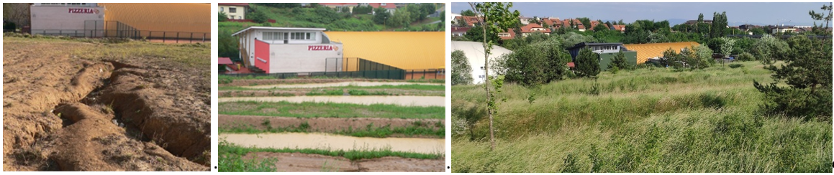
Technical Solutions of Water retention measures

Slide 3
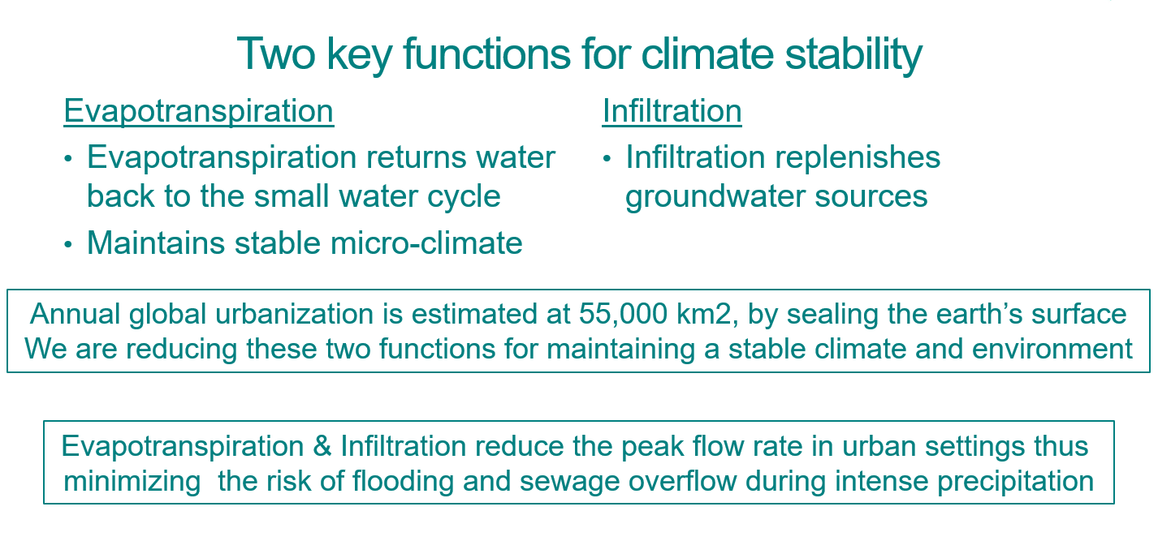
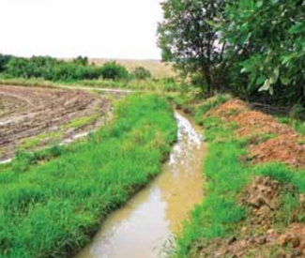
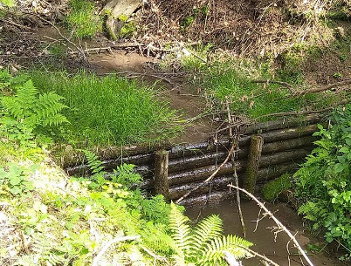
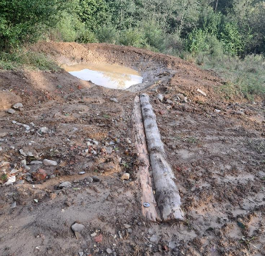
Technical Solutions of Water retention measures
Help maintain clean water in our rivers by filtering rainwater before entering the local stream
Help maintain a healthy local water basin
Increase the healthy function of the rural landscape
Provide shelter and sustenance for animals and birds
Prevention to protect people and property before the element's calamities
transform dried country on fertile the country
Create working opportunities
Run-off retention and slowing down
Erosion prevention
Stream / river bed stabilization

Slide 4
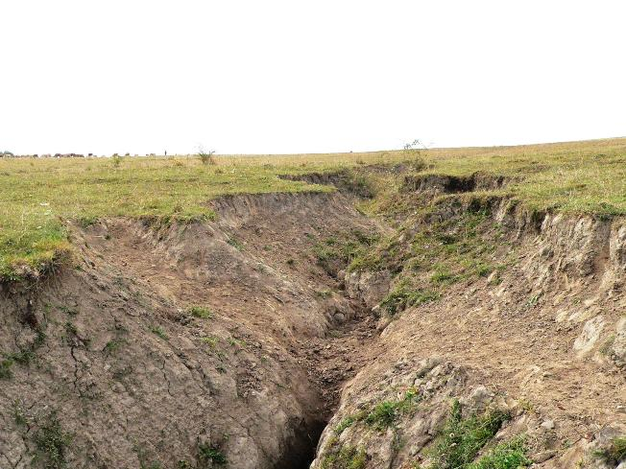
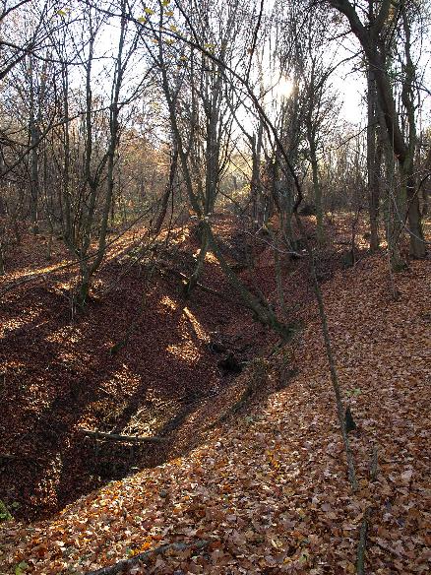
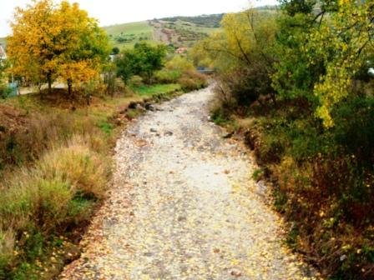
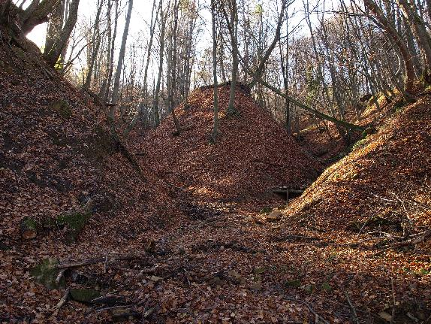
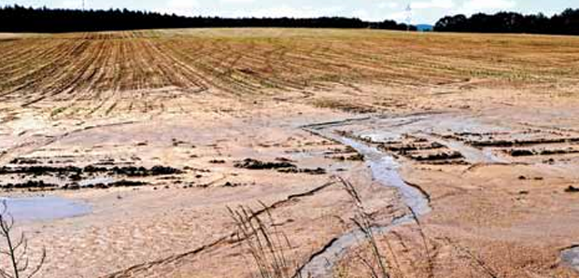
Topography analysis
Technical Solutions of Water retention measures
Four Characteristics:
Elevation - above sea level and relative to other regional elements
Slope - steepness percent or horizontal to vertical ratio
Aspect - orientation of the face of the slope
Landform - shape, profile, mass, volume

Slide 5
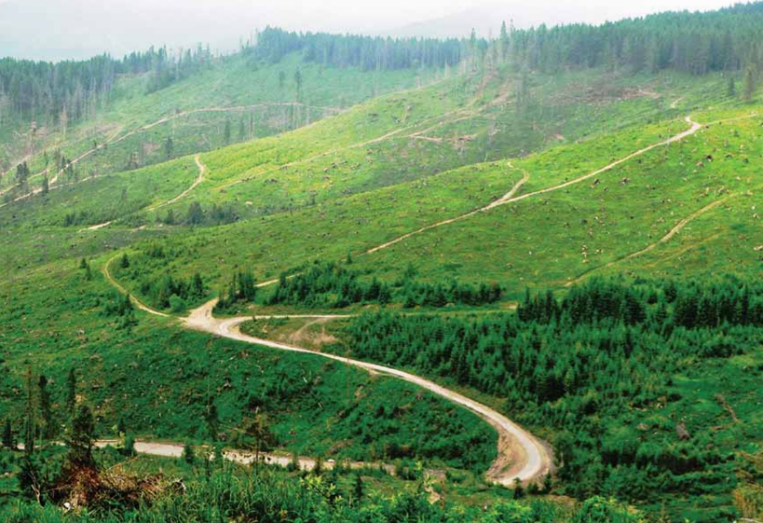
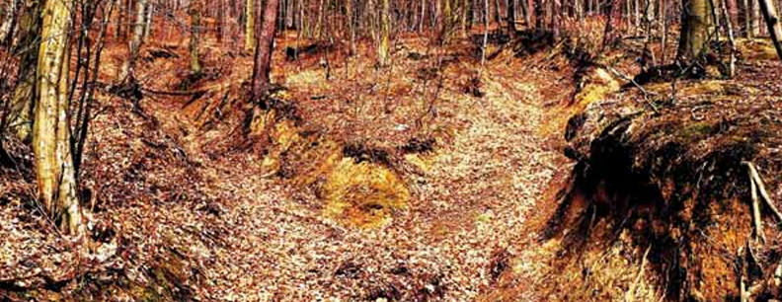
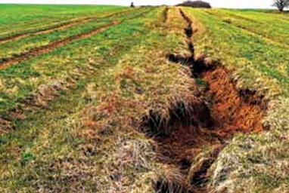
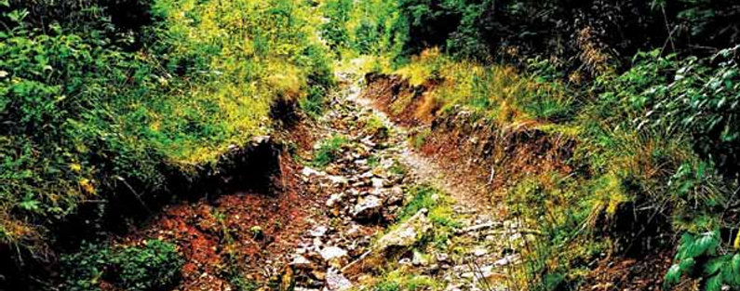
Terrain Analysis
Technical Solutions of Water retention measures
Damaged landscape increases flooding and drought risks

Slide 6
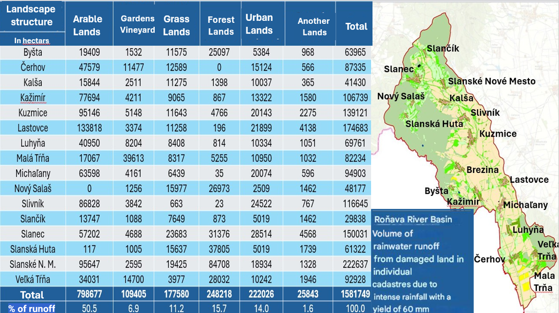
Technical Solutions of Water retention measures

Slide 7
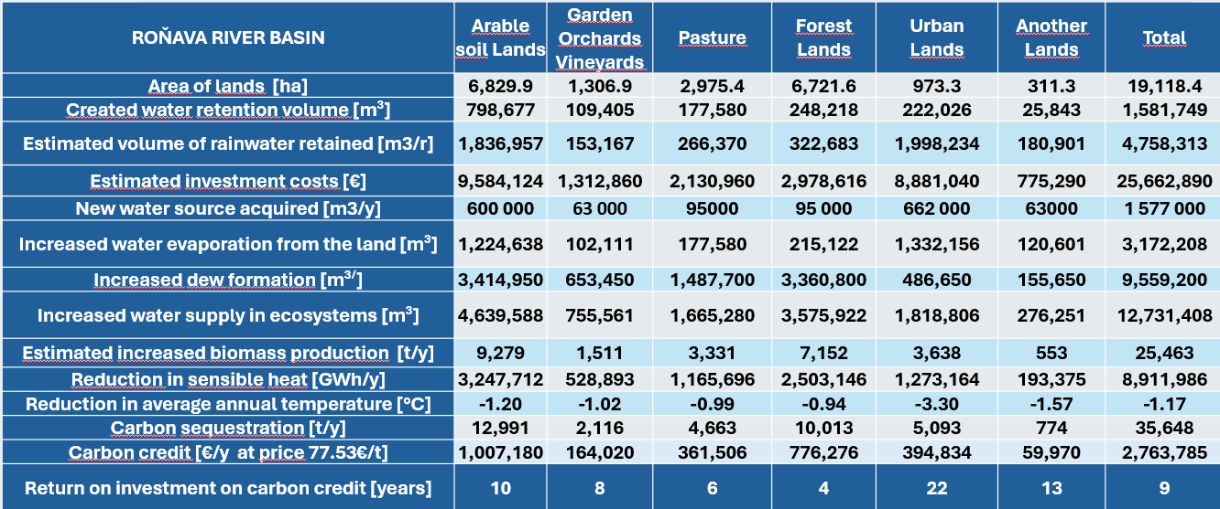
Technical Solutions of Water retention measures
Methodological approach of Water retention measures

Slide 8
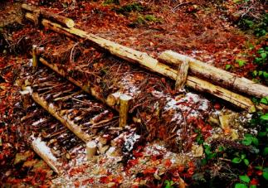
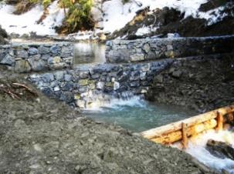
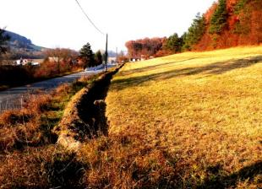
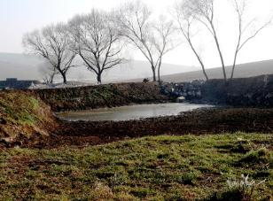
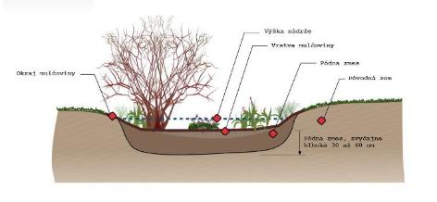
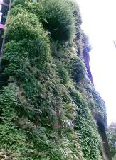
SOLUTIONS FOR THE CADASTER OF THE 1 MUNICIPALITY | Type of measure | M 1 | M 2 | M 3 | M 4 | M 5 | Urban | Sum | Dimension
Built-up areas | Green roofs and walls | 14,250 | 0 | 1,000 | 0 | 1,300 | 6,150 | 22,700 | m2​
 | Rain gardens | 500 | 0 | 800 | 0 | 1,000 | 1,800 | 4100 | m2​
 | Underground tank | 0 | 0 | 0 | 0 | 0 | 20 | 20 | pcs
Paved roads | Infiltration trenches | 1,130 | 85 | 653 | 62 | 700 | 1,880 | 4,510 | m´
Unpaved roads | Infiltration trenches | 0 | 0 | 324 | 110 | 140 | 36 | 610 | m´
Forests | Dams | 4 | 3 | 76 | 15 | 72 | 5 | 175 | pcs
 | Road bumps and potholes | 0 | 0 | 33 | 0 | 33 | 0 | 66 | pcs
Permanent grassland | Contour lines . strips | 0 | 0 | 230 | 360 | 0 | 40 | 630 | m´
 | Soaking pits | 10 | 0 | 5 | 5 | 6 | 0 | 26 | pcs
Arable land | Contour lines . strips | 1,700 | 1,500 | 7,000 | 19,800 | 2,200 | 0 | 14,300 | m´
 | Small water tanks | 1 | 1 | 2 | 1 | 0 | 0 | 5 | pcs
 | Seepage pits | 0 | 8 | 12 | 0 | 13 | 0 | 33 | pcs
Other areas | Seepage pits | 13 | 0 | 0 | 0 | 0 | 2 | 15 | pcs
Gardens | Water and seepage areas | 0 | 0 | 0 | 0 | 0 | 3050 | 3050 | m2​

Slide 9
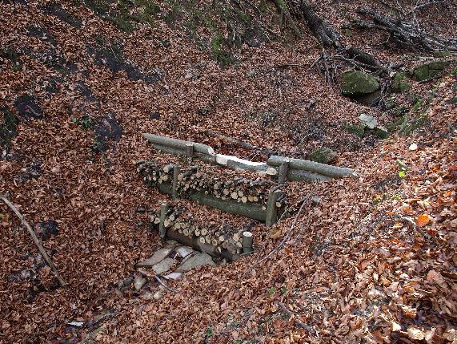
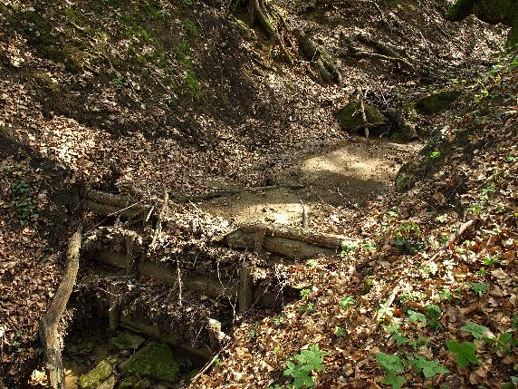
Small check dams
Technical Solutions of Water retention measures
On sediments embankment will arise new growth , what significant way will contribute to restoration and good condition stands.
Size , type and spacing dam they are based on the characteristic relief , in valleys and in erosive ones grooves with admits variability waterproof space from 5 m³ to 100 m³.
In general applies procedure that at cascading building dam with begins always on the highest point.
The most suitable provision for gorges a erosive grooves they are check dams.
It is advisable to build dams in erosion ravines and grooves, ravines, in small streams, in streams that periodically dry up.
Dams quickly get stuck with sediments and wood in sediments with preserves and lasts several decade.
Dams with so they will become artificial ones floodplains , which they will to withhold rainy water during precipitation.
By creating cascades you stabilize erosive grooves and ravines.
Prevention of landslides and more deepening gout ravine.
In sediments with they will to create supplies waters.
2013
2016

Slide 10
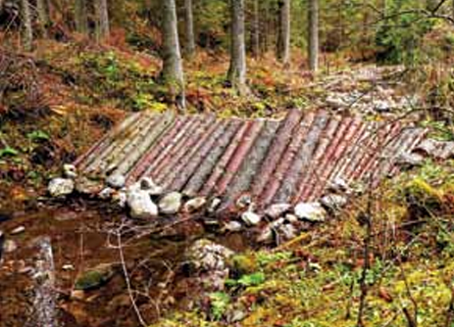
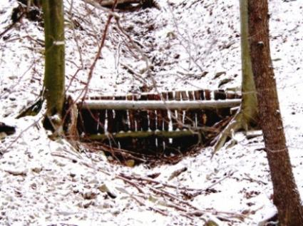
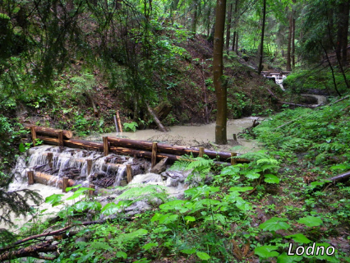
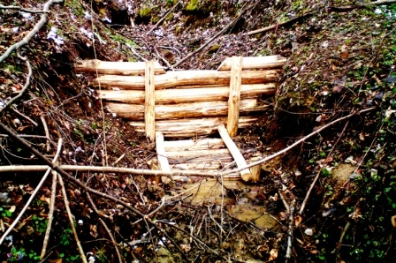
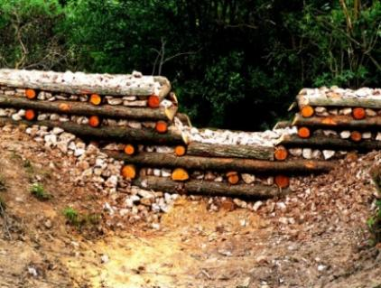
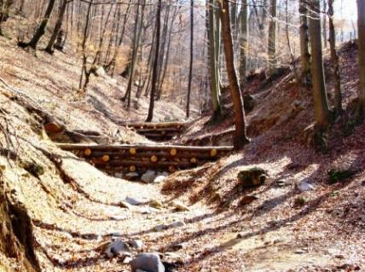
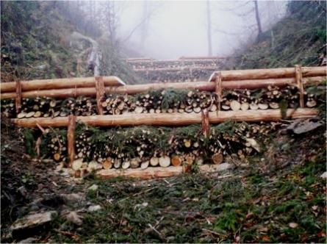
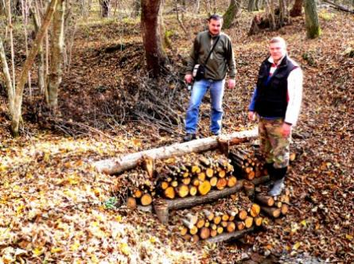
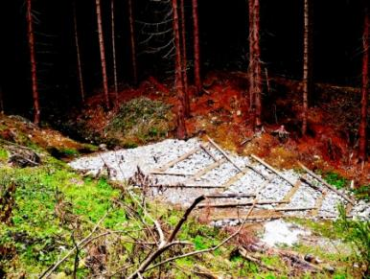
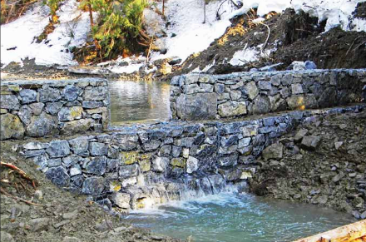
Types of check dams
Stake check dams
Technical Solutions of Water retention measures
Wooden dams
Log cabin dams
Layered check dam
Stone sprinkled dams
Gabions dams

Slide 11
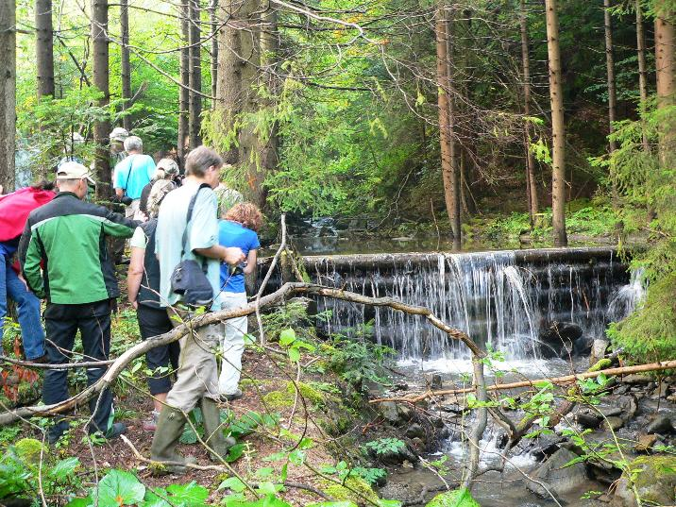
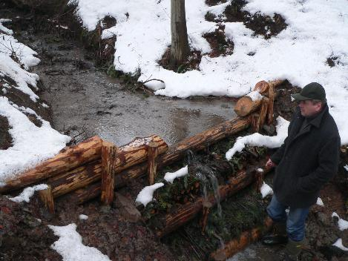
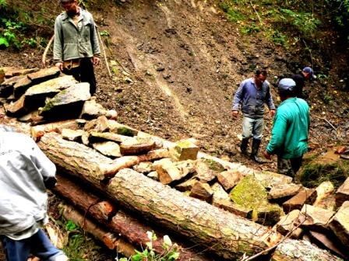
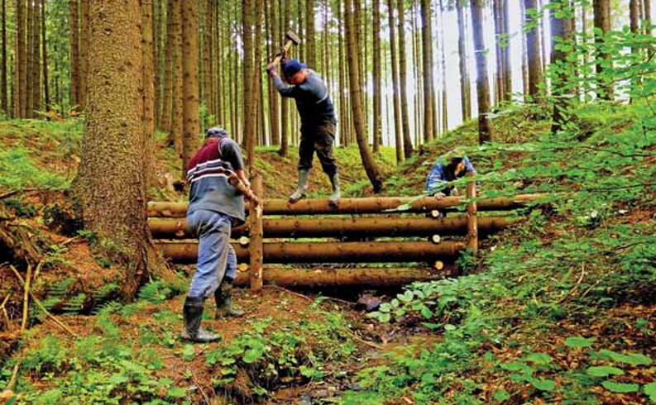
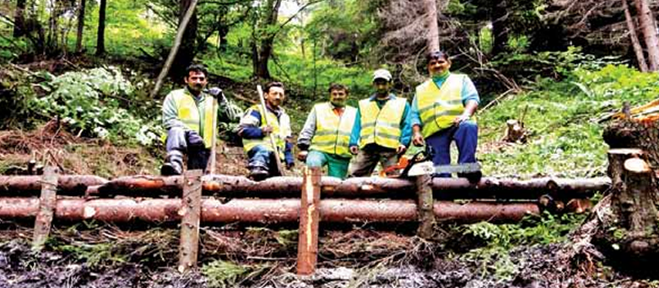
Technical Solutions of Water retention measures

Slide 12
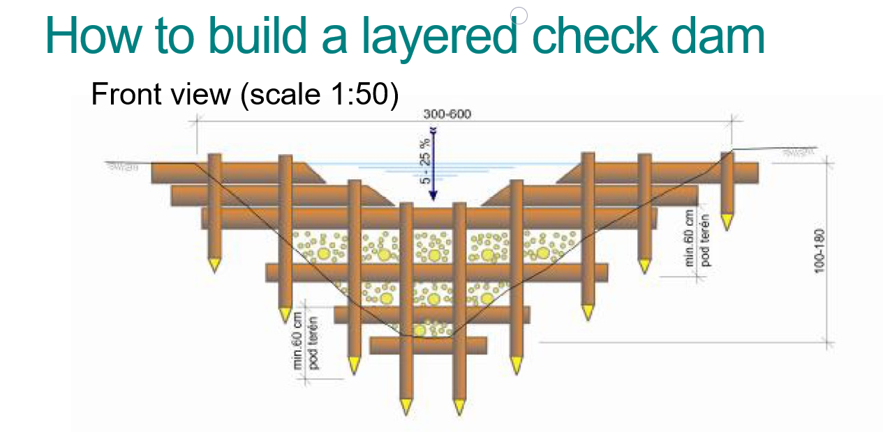
Technical Solutions of Water retention measures

Slide 13
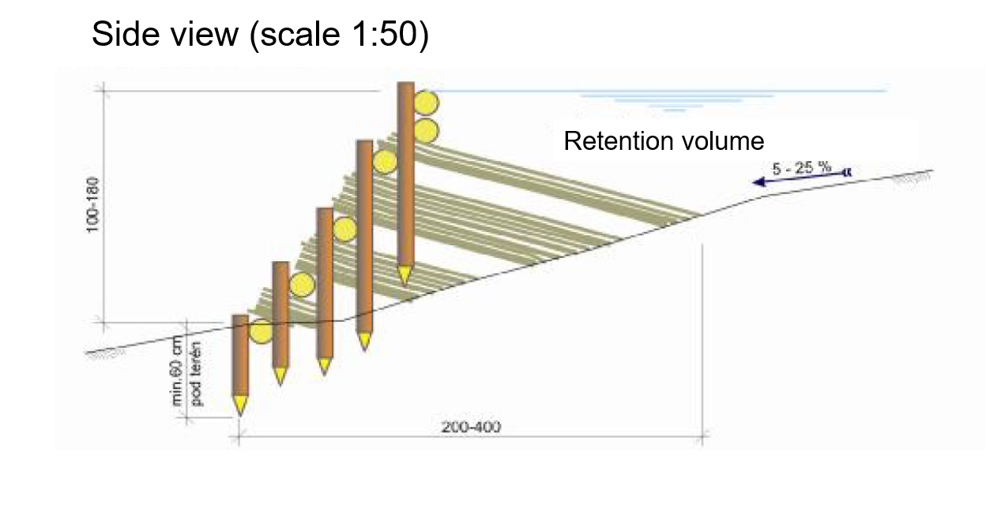
Technical Solutions of Water retention measures

Slide 14
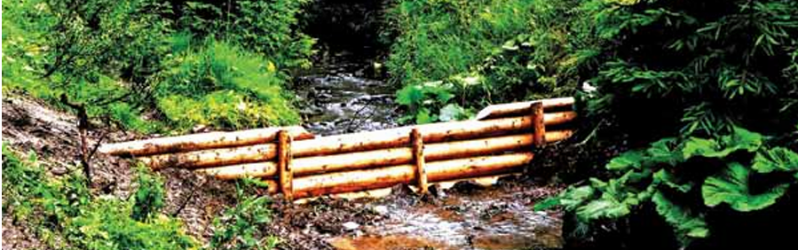
Stability and durability of check dams
The entire transverse and cross-sectional structure is stabilized by wooden stakes 8-12 cm in diameter which are hammered into the stream bed until they cannot be wedged.
These three elements are interconnected by nails of appropriate size or wire.
If using coniferous timber, then it is vital to remove the bark from the logs and stakes.
Use of on-site material.
Natural material is in tune with nature protection and cultural heritage and customs.
Considerations for design and implementation of check dams:
Synergy with forestry and agricultural landscape.
Placement of check dam in the narrowest profile of the stream bed and directly against the current while simultaneously ensuring that the retention area achieve its maximum size.
Technical Solutions of Water retention measures
The main element is its proper construction.
The transverse wooden logs should be layered with branches and pulp (fascines) along the profile of the corridor.
It is important to reinforce the edges of the logs and fascines with stones and soil to ensure their stability.
The embedding of cross-cuts in between the transverse logs and fascines on the slope spanning a height of 1 to 1.5 m within the space between the dam walls.
This space should not exceed the combined diameter of the logs used so that these cross cuts are firmly in place (20-30 cm).

Slide 15
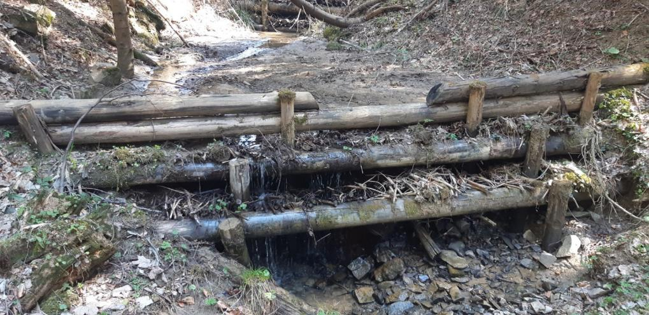
Mistakes to be avoided
Technical Solutions of Water retention measures
Poorly inserted wooden stakes
Angle of check dam leaning downstream of current
Improper embedding of cross-sectional logs into the slope.
Insufficient width and length of transverse logs and fascines of the check dam.
Improper laying of the base log (log should be placed just below the corridor surface).
Insertion of thick nails near the edges of the logs (results in split wood).

Slide 16
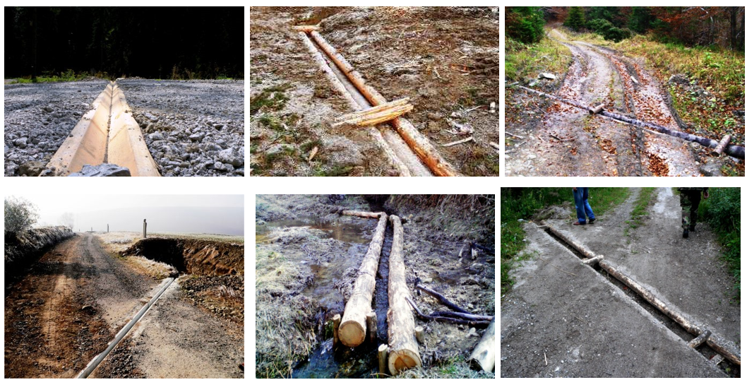
Surface cross drains
Technical Solutions of Water retention measures
Soaking space at the same time limits erosion soil especially if this one space combined with unloading stone under the outlet surface cross drain points.
Surface cross drains they have to be in moderation slope in the direction drain water , so that it happens in what the biggest measure to their self-cleaning .
Necessary condition functioning built networks surface cross drain points is their maintenance and cleaning.
Surface cross drains they are the most suitable measure on forest and field roads and.
Surface cross drains on on the way we suggest type so that to everyone the surface cross drain was realized wateretention pit (capacity from 1-5 m³ ).
Shape of waterretention pits is not important .
Important however , it is to water from the surface cross drain did not flow into the ravine , or directly into the stream , but was collected in water retention pits.
Surface cross drains on forest and field on the way with they recommend plant at intervals of 40 m. On sloping slopes more as 12% sa recommends spacing between 20m surface cross drain points to avoid damage roads.

Slide 17
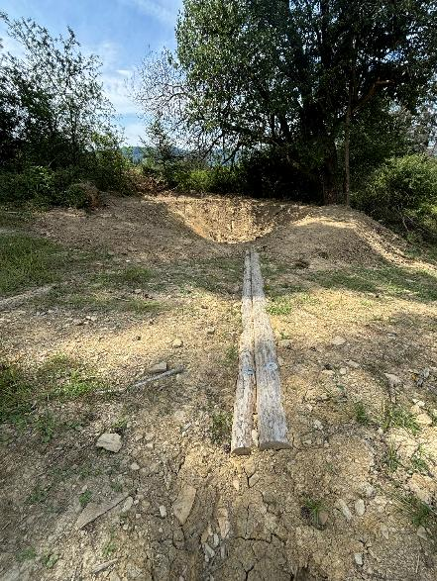
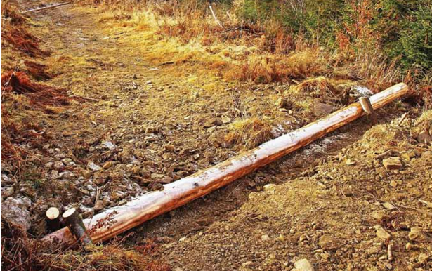
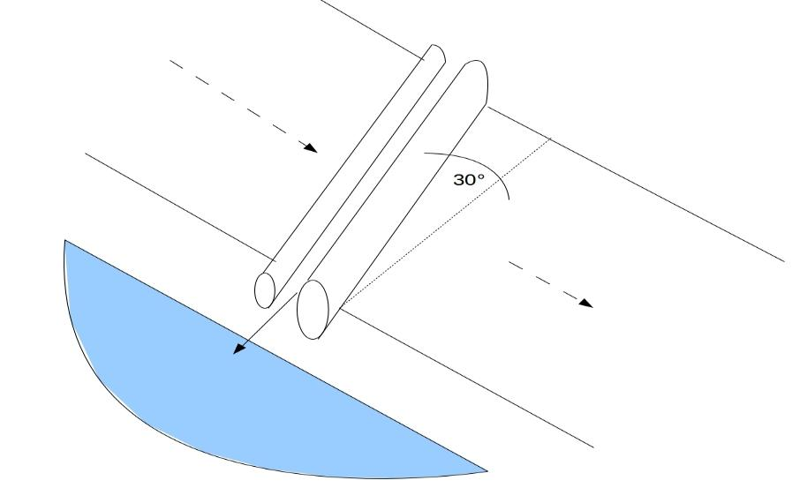


Surface cross drains
Technical Solutions of Water retention measures

Slide 18




Contour trenches
This one type measures causes small revolution in agriculture the country , because forces farmers plow along the contour and not along the slope.
This proposed solution fundamental way will support maintenance nutrients and creation humus in the soil agricultural countries.
Greenery attractive country creates enough escape area for small. game.
Technical Solutions of Water retention measures
A suitable measure on meadows, permanent grasslands and arable land.
We always create trenches along the contour lines.
Recommendation of interrupting them so that there is no leakage collected rainy waters to their lowest points , so that the opposite effect does not happen
Trenches are necessary to interrupt in distances of 15-20 meters .
Recommended depth trenches is up to 1.2 meters.
Trenches are suitable implement on interface agricultural landscape and forest .
Like this solution will be detained rainy water irrigate root zone forest ecosystems .
Along the trenches on bottom side it is convenient to plant trees with a spacing among 5 meters.

Slide 19




Contour trenches
Technical Solutions of Water retention measures
Cross-section of the contoured infiltration trenches, intermittent every 20 meters

Slide 20

Soaking pits
From soaking I am with gradually they create wetland ecosystems that with they will become included complex preventive flood protection.
They will significant ecostabilizing element forestry countries with significant benefit for conservation biodiversity.
Selection locations on building up soaking pit is necessary carefully consider , so that it corresponds to the total strategic intention.
Technical Solutions of Water retention measures
Significant revitalizing element in the rural country they are soaking pits which they collect rainy water.
Of them with gradually they create wetlands and buffering zones for free living animals.
They are ecostabilizing elements in country, contributing to the increase supplies underground waters.
Increased vapor water from soaking pits gradually heal microclimate.
These measures significantly contribute also to the formation of dew in the land , which is dry periods significant benefit for maintenance moisture in the country.
This measure is also preventive a measure against drought , from which they arise risks fires.
Soaking pits we recommend implement with maximum deep into two meters with wateretention with a volume of 300 m³.

Slide 21

Water retention pond/fishpond
Technical Solutions of Water retention measures

Slide 22






Technical Solutions of Water retention measures

Slide 23





Soaking pits

Slide 24






BIOCLIMATIC PARK
2022
2014
2014
2015
2022
2021

Slide 25


Technical Solutions of Water retention measures
YOU CAN HEAL THE CLIMATE OF PLANET EARTH
Redirection of rain to the Bioclimatic Garden
IF YOU WANT TO HAVE A COOLER ENVIRONMENT NEAR YOUR HOUSE, MAKE A BIOCLIMATIC GARDEN
WWW.WATERHOLISTIC.COM

Slide 26





Technical Solutions of Water retention measures
Infiltration
ditches
Bioclimatic Rain
garden

Slide 27



SO SHOULD BE PUBLIC SPACES IN OUR CITIES AND VILLAGES

Slide 28







Technical Solutions of Water retention measures
Proposal of types of measures in forest landscape structures
Restoration of tree planting, preservation of seedlings, support for the establishment of forest nurseries.
Catching water flowing from the forest, forest cover - small water reservoirs, breeding ponds.
Surface cross drains with soak pits on forest roads, soaking pits.
Small dams in ravines and erosion grooves.
Rainwater retention measures in the forest.
Change the way of forest planning and management.

Slide 29







Technical Solutions of Water retention measures
Proposal of types of measures in agricultural landscape structures
Windbreaks, boundaries, biobelts with rainwater harvesting in retention elements - small water reservoirs -contour trenches- water farms - diversification.
Agroforestry - strips of trees and draws on arable land.
Evaluate the functionality of drainage systems from the point of view of drought - melioration channels.

Slide 30







Technical Solutions of Water retention measures
Proposal of types of measures in urbanized landscape structures and transport infrastructure
Legislative instruments - leave water in the municipality - ensure a suitable ratio between the concrete and vegetated part of the landscape.
Collection of rainwater from paved areas to green areas and trees, or into collection tanks and its reuse - rain garden, green roof, infiltration facilities.
Decentralization of wastewater treatment.
Root water purifier - water recycling in the system.
Support of meadow ecosystems - determining the height of grass mowing.

Slide 31



GREEN RESTORATION PLAN OF THE KOŠICE REGION, SLOVAKIA 2020 - 2030
Technical Solutions of Water retention measures
Landscape and watershed Recovery Programme for the Košice Region of Slovakia | Case studies | Discover the key services, thematic features and tools of Climate-ADAPT Climate-ADAPT

Slide 32



Technical Solutions of Water retention measures
GLOBAL GREEN RESTORATION PLAN https://www.ludiaavoda.sk/data/files/149_kravcik_global_action_plan.pdf

Slide 33







Thank you!
Danka Kravčíková
Michal Kravčík
WATER HOLISTIC
PEOPLE AND WATER
Member of DALIA, SystR, Co-ADAPT and LAND4CLIMATE consortium
peopleandwater.international
www.waterholistic.com
Daia, April, 15th, 2026

