Slide 1
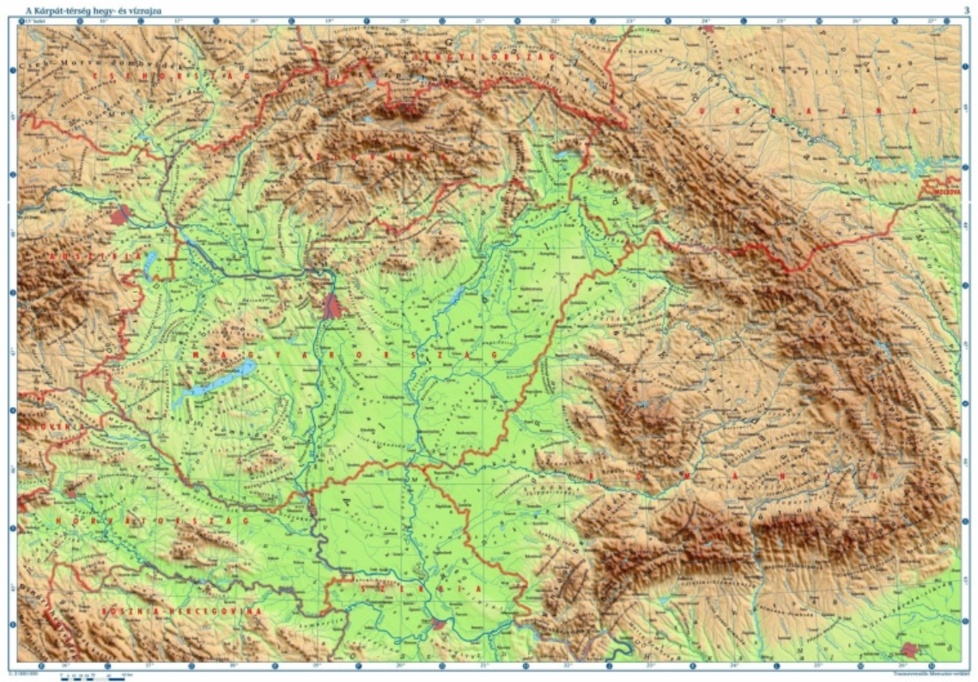

Nature-based solutions for water, soil and climate regulation
Košice
Daia
Michal Kravčík, Danka Kravčíková, Slovakia
peopleandwater.international/www.waterholistic.com
Daia - Water Holistic.,
April 15th 2026

Slide 2
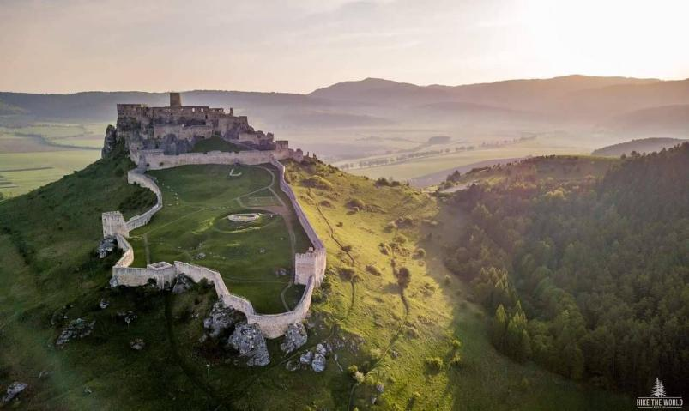
/Ibrahim Ibn Jacqub at-Turtushi, About the Western Slavs, middle of the 10th century/
Daia, Romania, Water Holistic., April 15th 2026
“The Slavonic countries stretch from the Mediterranean Sea through to the Northern Seas... The Slavs build most of their own castles...on meadows rich in water and bushes...they reside in the most fertile lands, rich in different means of subsistence. They till the soil very intensively to provide themselves with enough food...Famines caused by long-term drought don´t exist in (their) land. On the contrary. Famine can break out when it rains too much... If it rains only a little, they do not have poor results, because these lands are damp...“

Slide 3
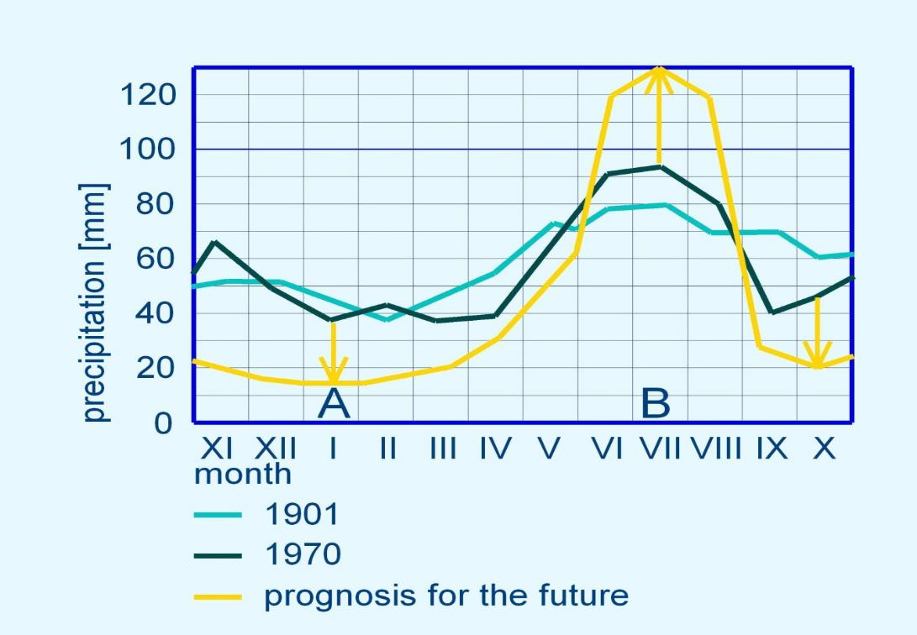
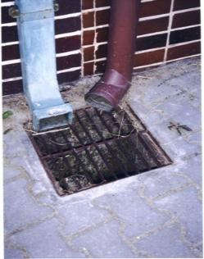
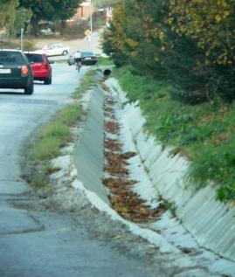
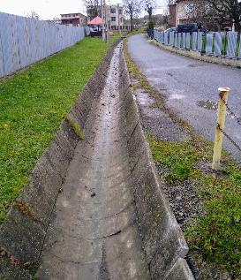
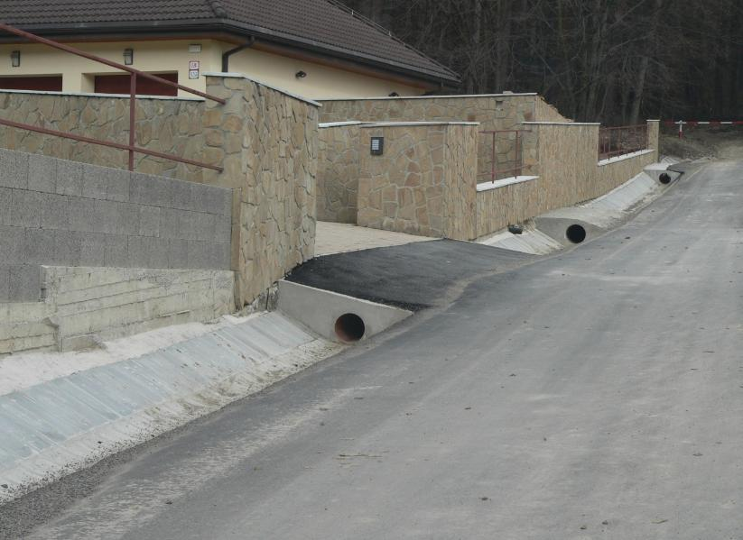
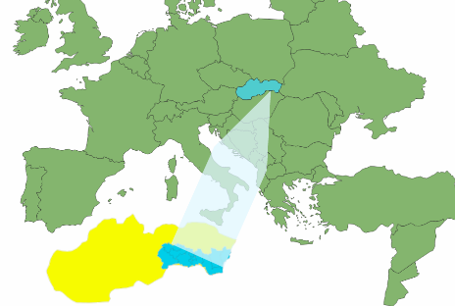
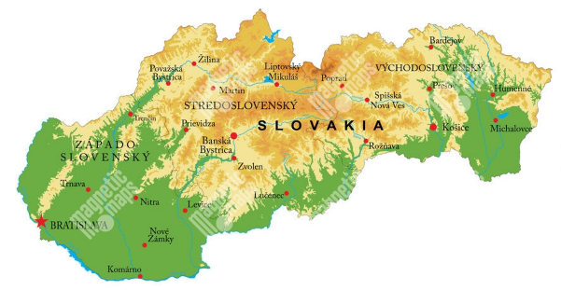
Daia, Romania, Water Holistic., April 15th 2026

Slide 4
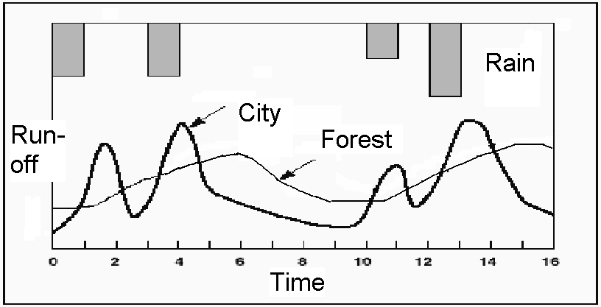
Daia, Romania, Water Holistic., April 15th 2026

Slide 5
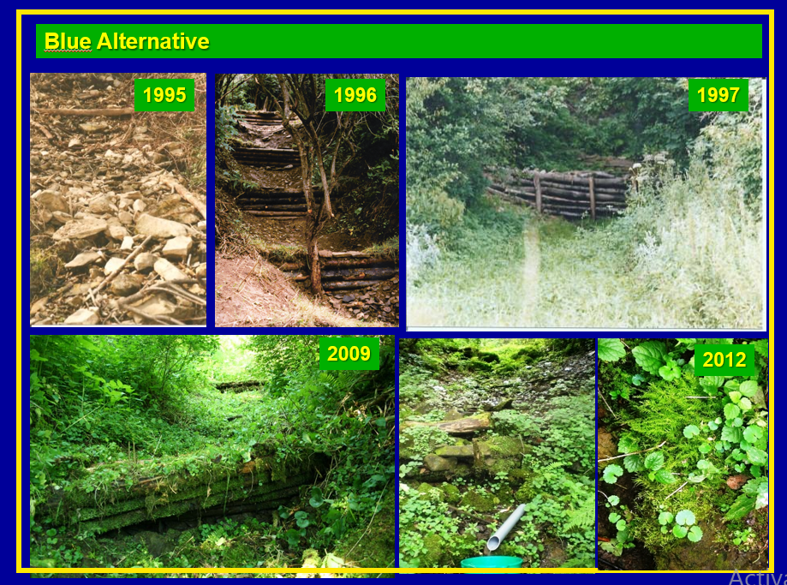


Daia, Water Holistic,
April 15th 2026
A BIT
OF HISTORY
Tichý Potok 1994

Slide 6
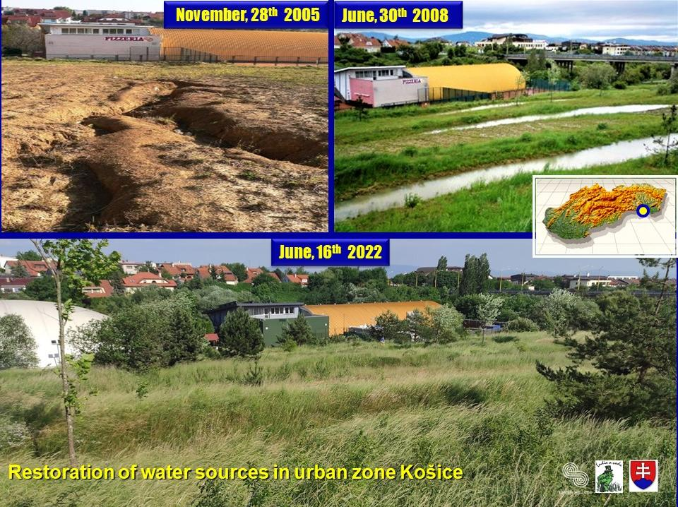

Daia, Water Holistic,
April 15th 2026
A BIT
OF HISTORY
KOŠICE 2005

Slide 7
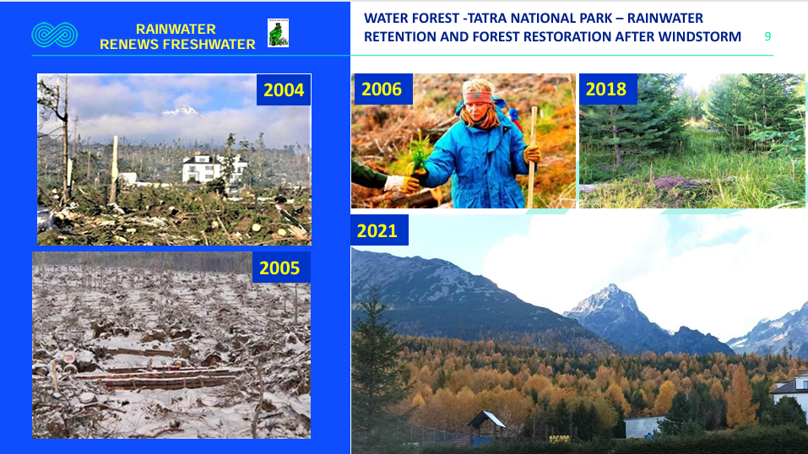


Slide 8
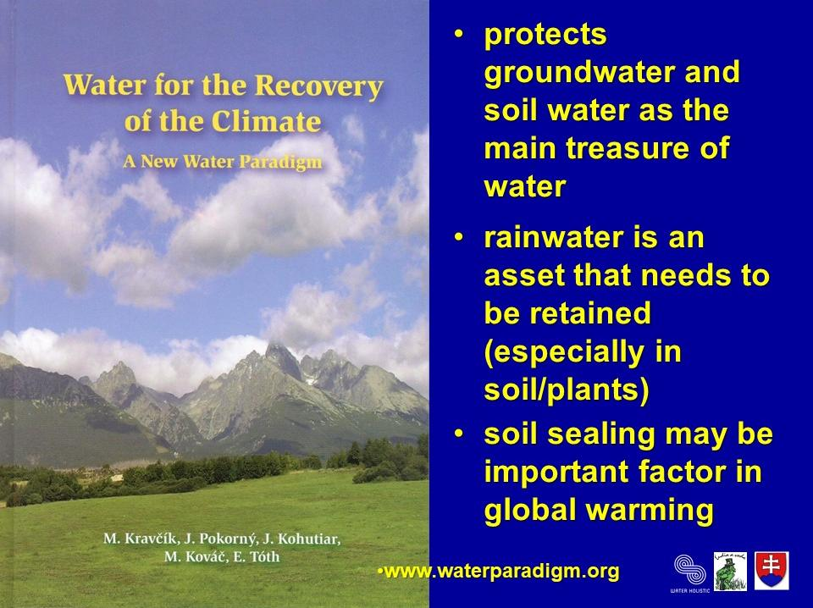

Daia, Water Holistic,
April 15th 2026
A BIT
OF HISTORY
BRATISLAVA 2007

Slide 9
New water paradigm
Draining may be important factor in global warming
The impact of changes in the water cycle on global warming
Land usage has a fundamental impact on the influence of the water cycle
Daia, Water Holistic,
April 15th 2026
Old water paradigm
Water on land does not influence global warming
Impact of global warming on the water cycle
Land usage has minimal impact on the water cycle

Slide 10
New water paradigm
Extremes of weather are the main climatic problem for humanity
Reason for extreme weather are changes in the water cycle
If the new approach to water is applied, a recovery of the climate can be expected within decades
Daia, Water Holistic,
April 15th 2026
Old water paradigm
Global warming is the main climatic problem for humanity
The reason for extreme weather effects is global warming
Adverse climatic trends will increase, mitigation can perhaps be expected within a horizon of centuries

Slide 11
New water paradigm
Water and vegetation alleviate unwanted temperature differences;
Cloudiness moderates the intensity of solar radiation falling on Earth's surface
The main source and reserve of water is groundwater
Daia, Water Holistic,
April 15th 2026
Old water paradigm
Vegetation is not ideal from the point of global warming (low albedo)
Water vapor increases the greenhouse effect
The main source and reserve of water is surface water

Slide 12
New water paradigm
Rainwater is an asset that needs to be retained in soil/plants
Water can be used for more purposes, then purified and recycled
Water supplied through a system divided into potable and utility water
Daia, Water Holistic,
April 15th 2026
Old water paradigm
Rainwater is an inconvenience, needs to be quickly removed
Water is used only once for one purpose and then is sluiced away
Water supplied to communities primarily through a system of mains with "potable" quality water

Slide 13
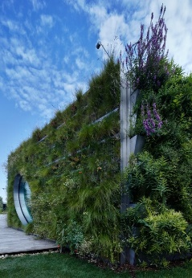
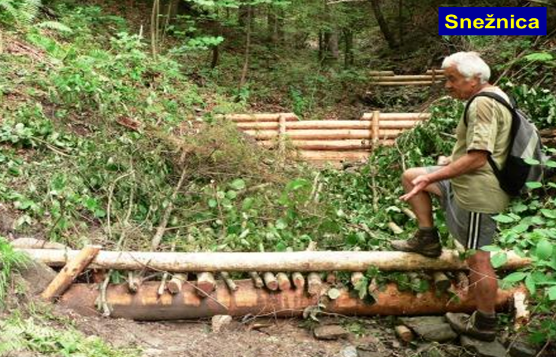
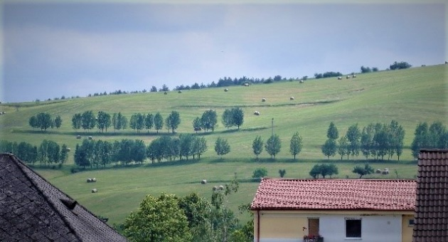
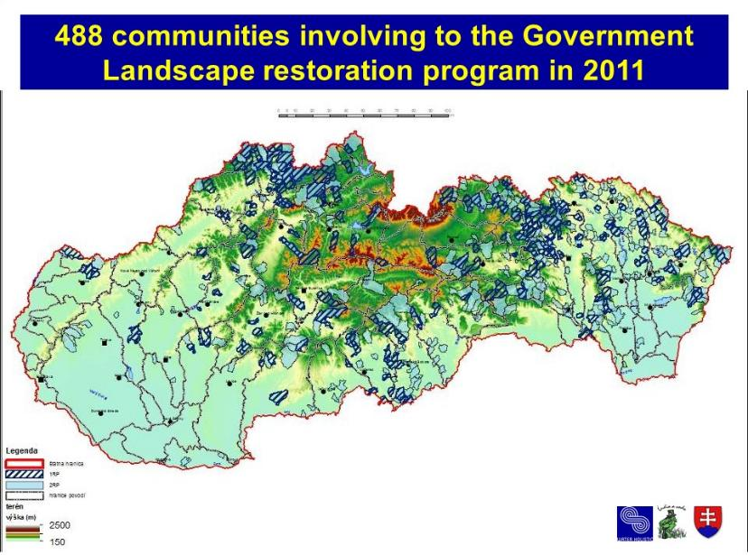
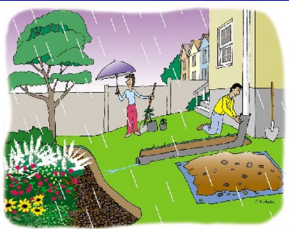
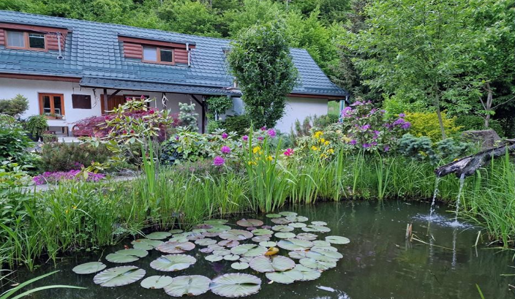
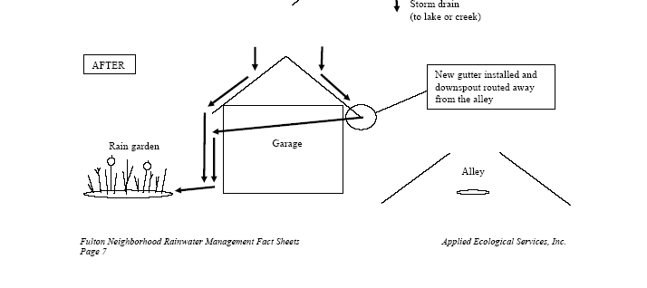
Daia, Water Holistic,
April 15th 2026
Slovak Government
Restoration Programm
2010-2012

Slide 14
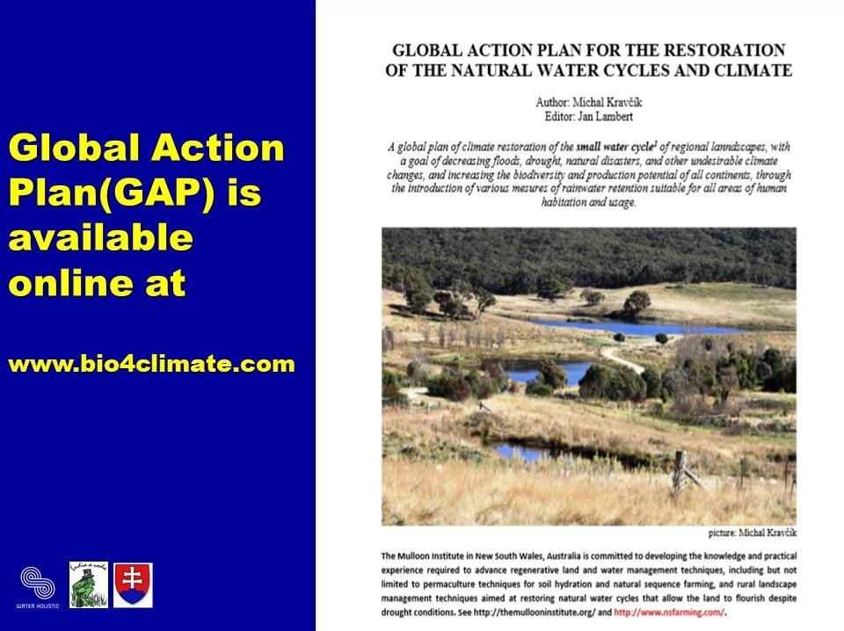
Daia, Water Holistic,
April 15th 2026
A BIT
OF HISTORY
Boston 2015

Slide 15
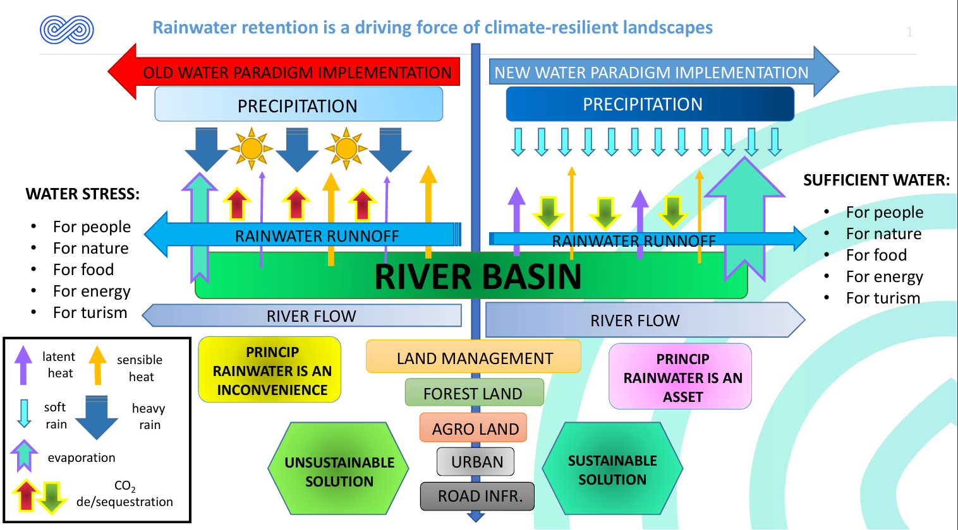
2018
Daia, Water Holistic,
April 15th 2026
A BIT OF HISTORY

Slide 16
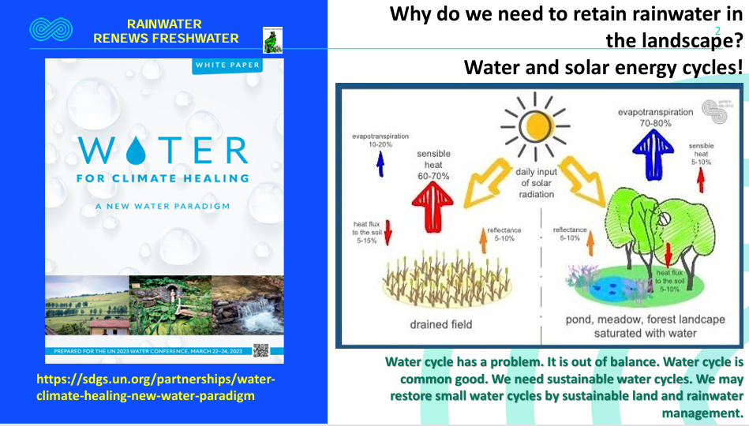
Daia, Water Holistic,
April 15th 2026

Slide 17
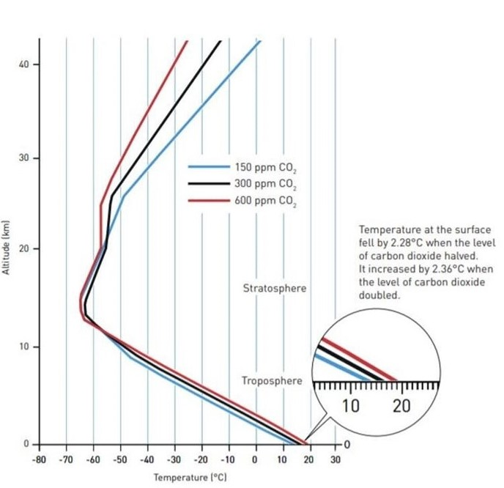
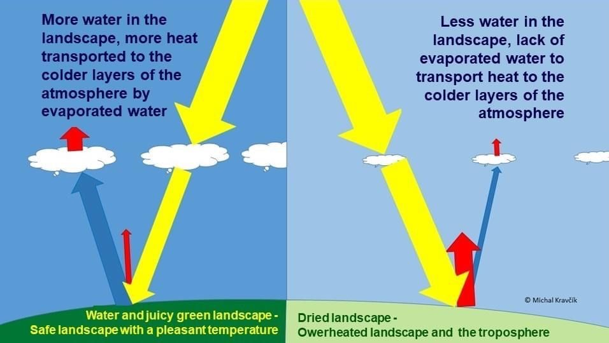
Daia, Water Holistic,
April 15th 2026
ABOUT 20 BILLION m3 OF RAINWATER SLUICED FROM MUNICIPALITIES OF EUROPE ANNUALLY, AND ABOUT 760 BIL m3 SLUICED FROM ALL CONTINENTS

Slide 18
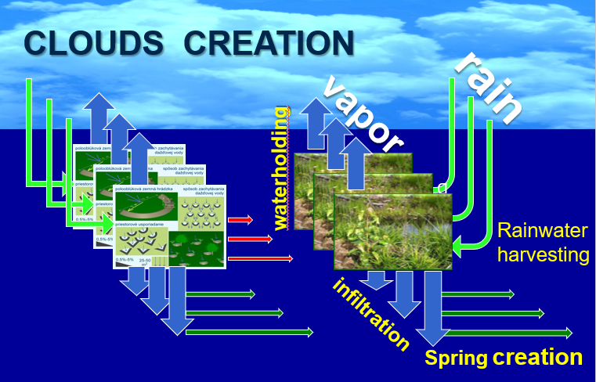
Daia, Water Holistic,
April 15th 2026

Slide 19
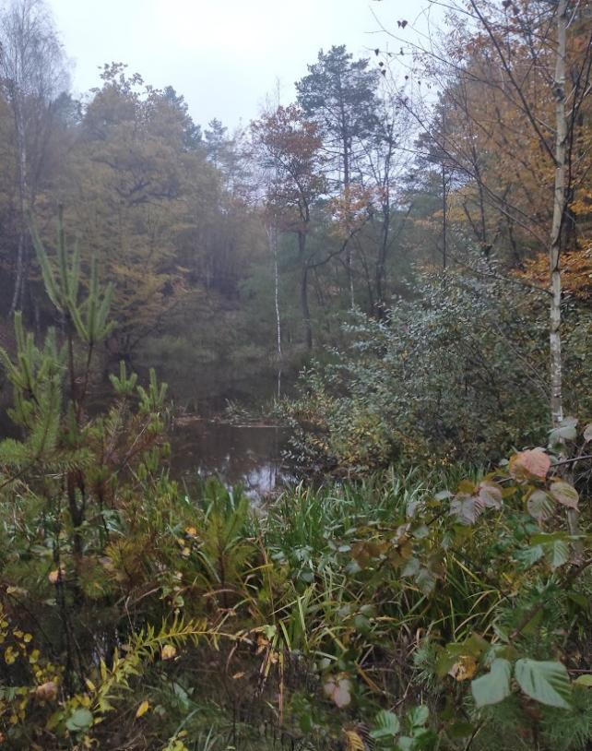
STOP FLOODS AND DESERTIFICATION
AND BRING BACK
WATER AND VEGETATION:
Daia, Water Holistic,
April 15th 2026
    Air-conditioning via short water cycle
    More biomass, more food
    Biodiversity increase
    Carbon sequestration
    Recycling of nurients and water
    Employment
    Any negative effect??
https://www.ludiaavoda.sk/data/files/44_kravcik-after-us-the-desert-and-the-deluge.pdf

Slide 20
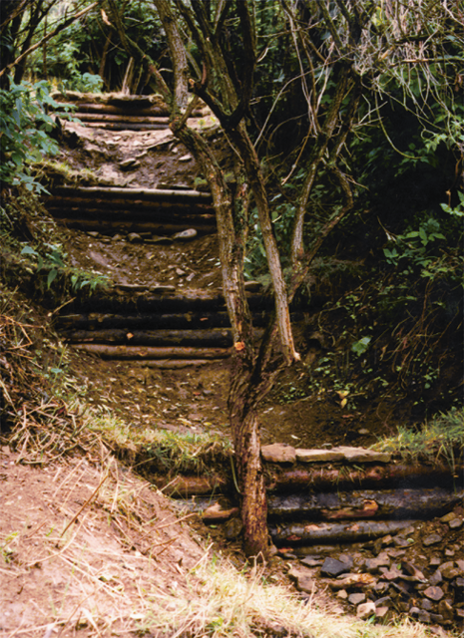
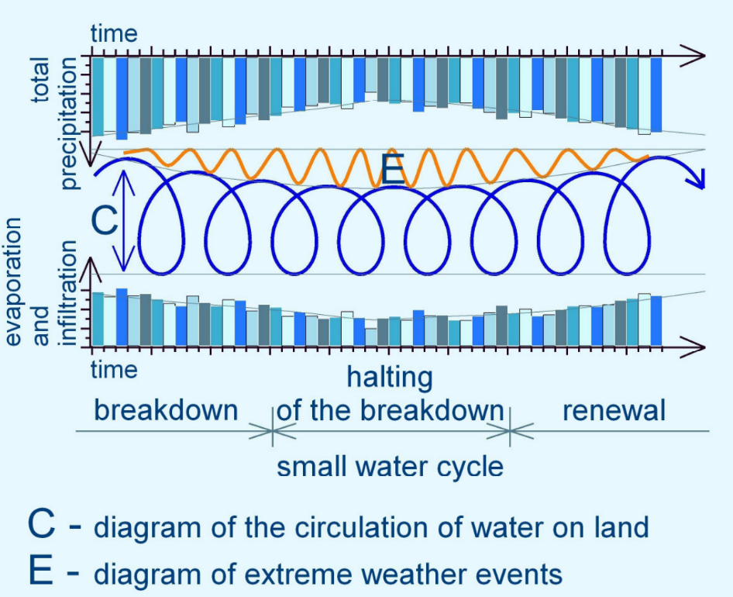
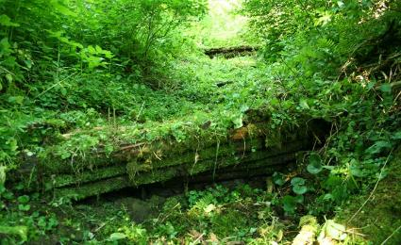
Daia, Water Holistic,
April 15th 2026
CURRENT TRENDS AND OPPORTUNITY FOR SMALL
WATER CYCLES RECOVERY -
BLUE ALTERNATIVE SOLUTIONS
1996
2016

Slide 21

Daia, Water Holistic,
April 15th 2026

Slide 22
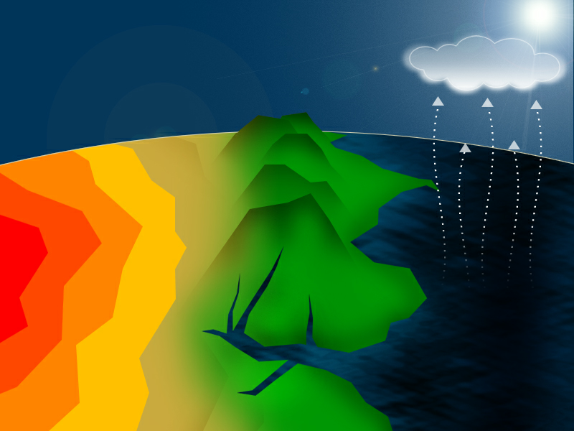
Daia, Water Holistic,
April 15th 2026

Slide 23
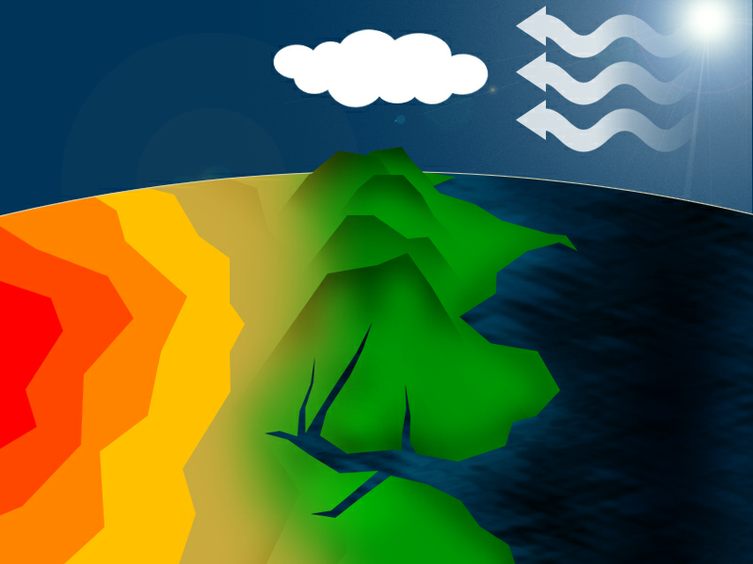
Daia, Water Holistic,
April 15th 2026

Slide 24
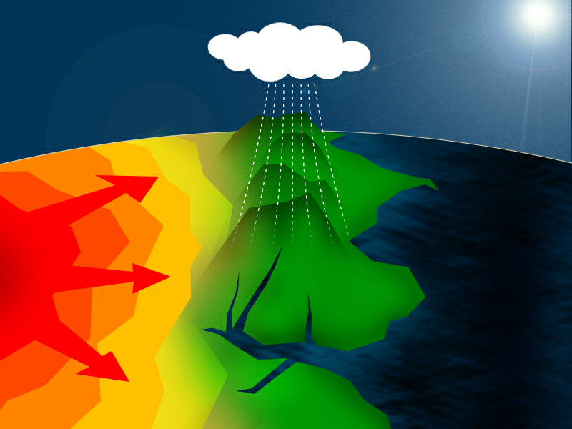
Daia, Water Holistic,
April 15th 2026

Slide 25
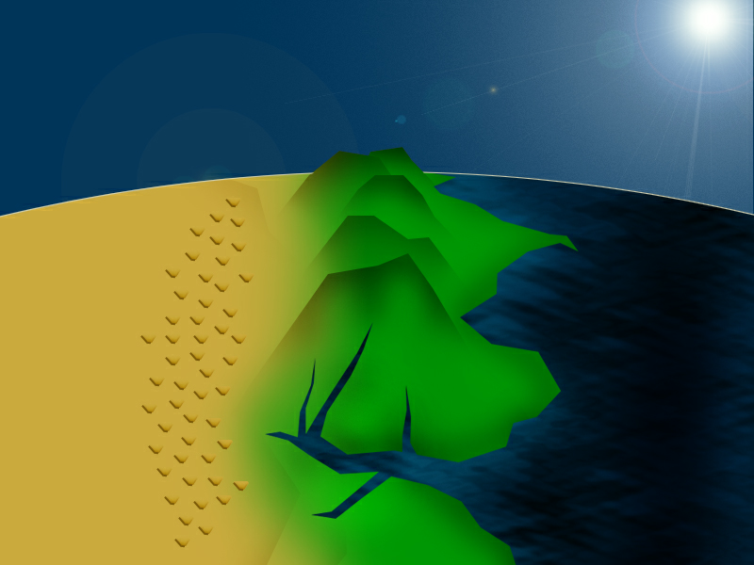
Daia, Water Holistic,
April 15th 2026

Slide 26
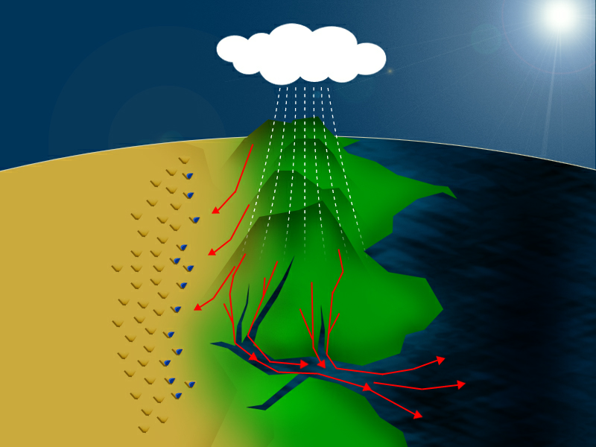
Daia, Water Holistic,
April 15th 2026

Slide 27
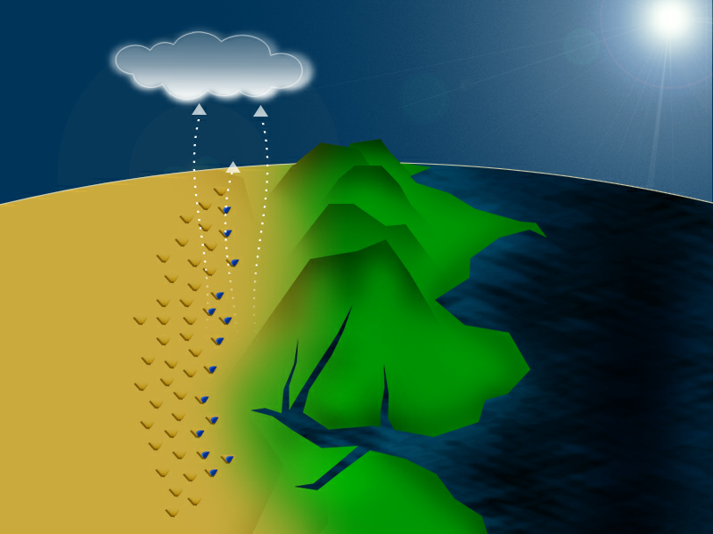
Daia, Water Holistic,
April 15th 2026

Slide 28
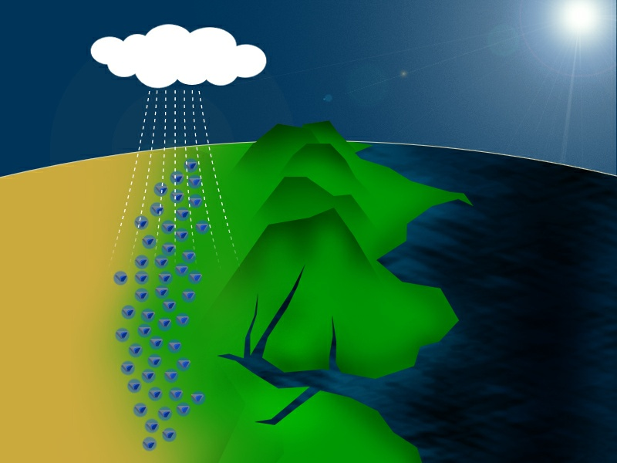
Daia, Water Holistic,
April 15th 2026

Slide 29
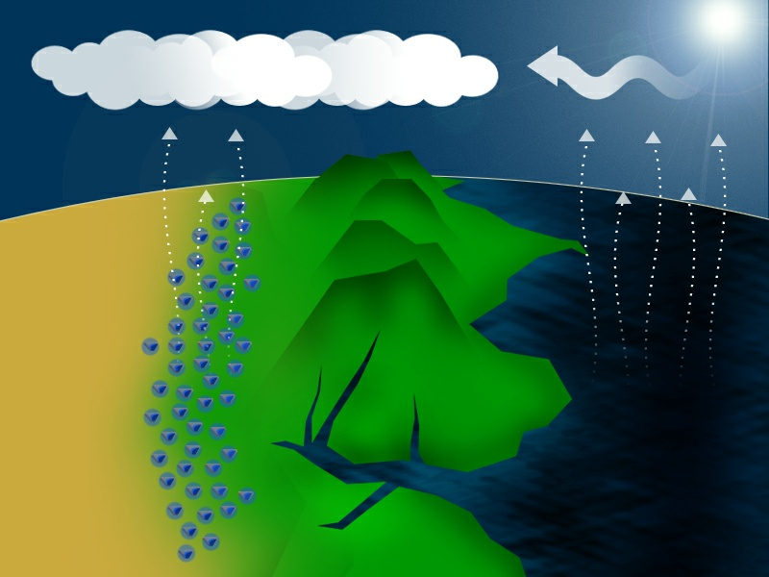
Daia, Water Holistic,
April 15th 2026

Slide 30
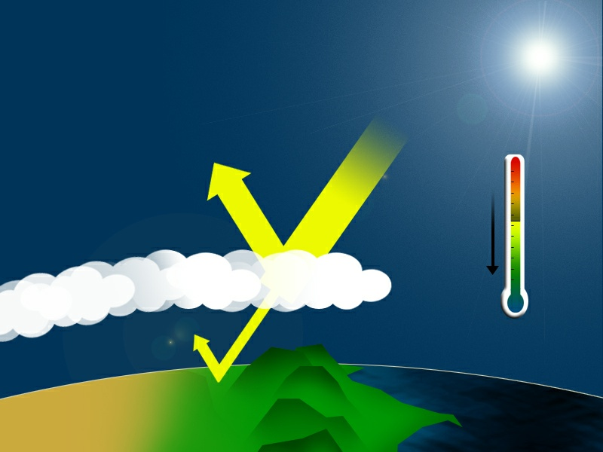
Daia, Water Holistic,
April 15th 2026

Slide 31
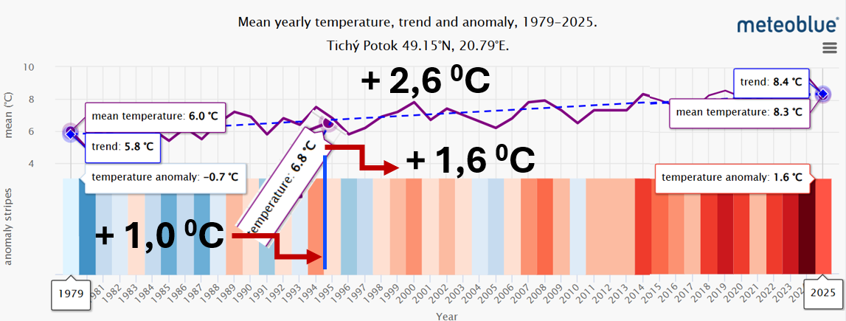
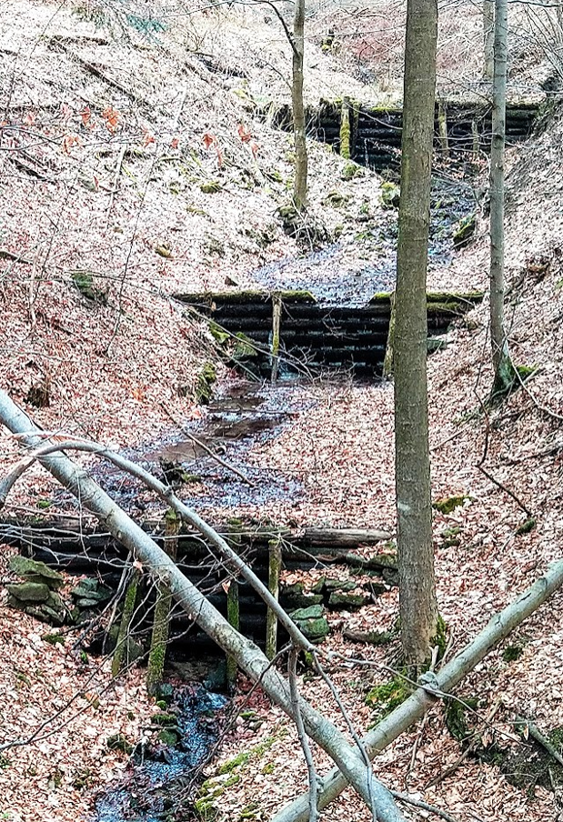
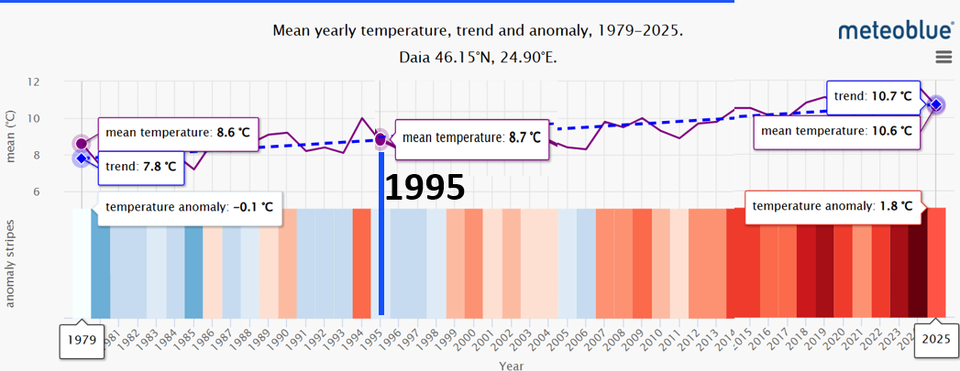
Daia, Water Holistic,
April 15th 2026
TICHÝ POTOK
DAIA
+ 2,9 ⁰C
?
+ 0,9 ⁰C
+ 2,0 ⁰C

Slide 32
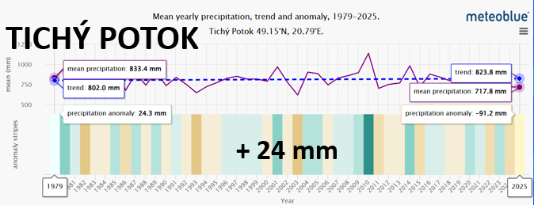
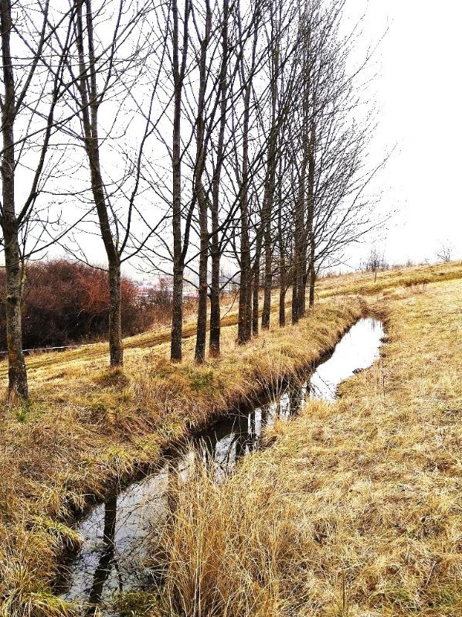
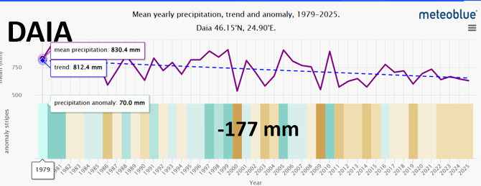
Daia, Water Holistic,
April 15th 2026

Slide 33
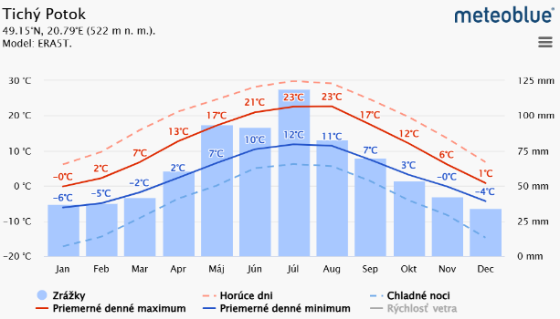
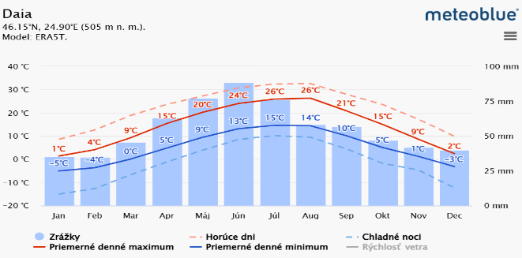
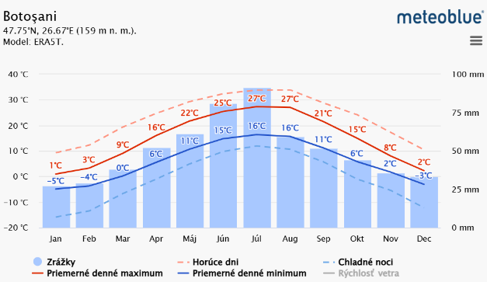
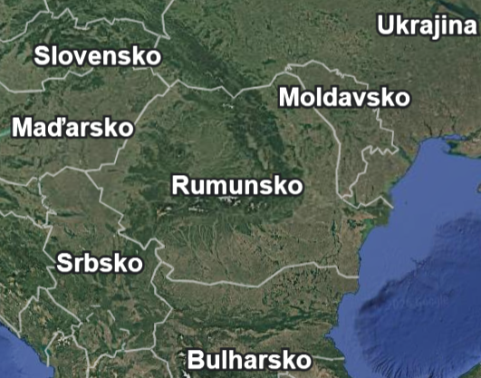






Slide 34



Daia, Water Holistic,
April 15th 2026
A NEW WATER PARADIGM
– WATER FOR THE CLIMATE HEALING
(https://sdgs.un.org/partnerships/water-climate-healing-new-water-paradigm)

Slide 35



Daia, Water Holistic,
April 15th 2026
The solution is
to return the lost water
to ecosystems.
There is no other way.

Slide 36

Thank You!
DANKA KRAVČÍKOVÁ/ MICHAL KRAVČIK
peopleandwater.international/www.waterholistic.com

